Slide 1
Recent Developments Combining Ensemble Smoother and Deep Generative Networks for Facies History Matching
汇报人：吕云雪
日 期 : 2020.6.19

Slide 2
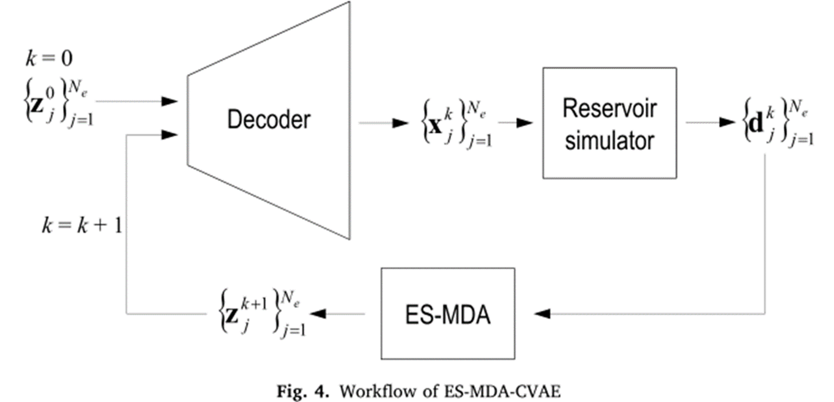
Introduction
• Why?
Because these methods rely on Gaussian assumptions, their performance is severely degraded when the prior geology is described in terms of com-plex facies distributions.
the vectors z are used as a continuous parameterization for history matching with ES-MDA.

Slide 3

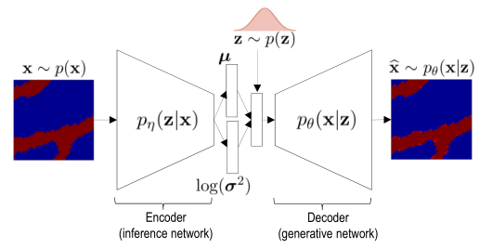
using deep variational autoencoders

Slide 4
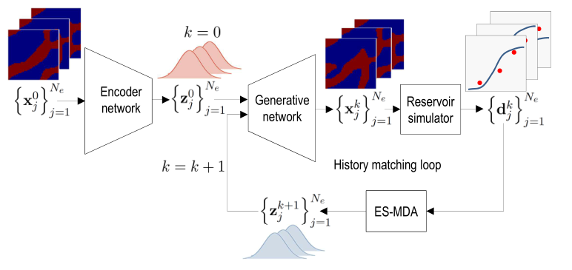
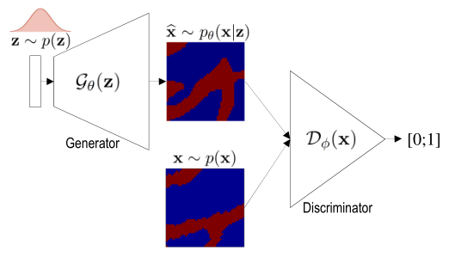
using deep generative adversarial network

Slide 5
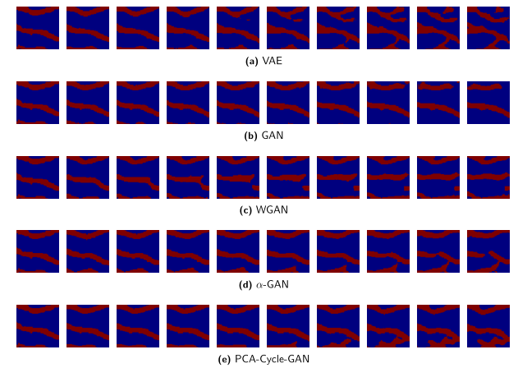
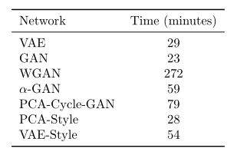
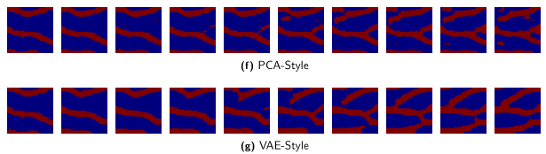

result

Slide 6
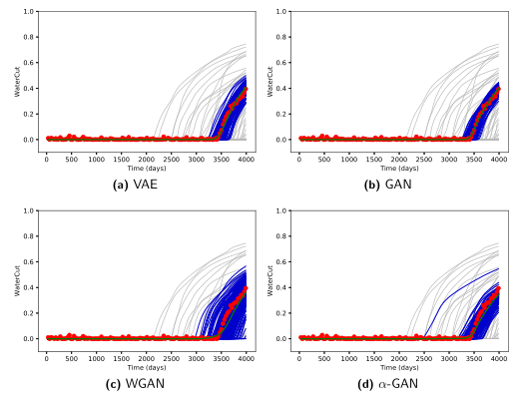
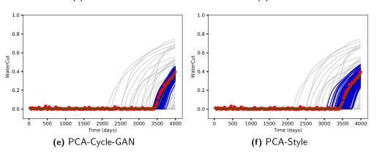
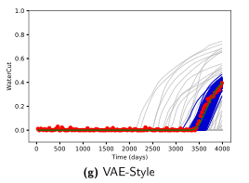

Slide 7
Problem
The latent vector z losses the spatial relation in the model such that it no longer possible to compute the spatial distance between a well, which represents the spatial location of the data, and a model parameter (entry of the vector z).

